Slide 1
Robo Advising! Making Investing Cheaper and More Likely
Erika Cunningham, Brian Putman, Bill Udeh, Alex Wise
January 4th, 2021

Slide 2
Agenda for Today
1
Our Topic and Why We Chose It
2
The Questions We Looked to Address
3
Data Sources and Cleaning
4
The Analysis
5
Our Conclusions
6
Postmortem
7
Q&A

Slide 3




Why We Chose This Topic
The Opportunity
The Solution
Create a Robo Advisor which uses diversified, low expense indexes, to make investing more accessible
1 | 26% of Americans have no retirement savings¹
2 | Among those aged 18 – 29, the number is even higher at 42%
3 | Often, individuals feel overwhelmed and don’t know where to start
4 | Showing the benefits of compound interest and low fee indexes, can be a great motivator to get people started
Ask the user basic questions to help guide them to a portfolio that meets their needs
Educate the user by providing them with information about each investment option
Show the investor the potential returns they could generate compared to just letting their money sit in savings
¹: 2018, Federal Reserve Economic Well-Being Report

Slide 4



Questions to Be Answered
How can we create an investment service that is both low cost, while still providing the client with guidance along the way?
Can we leverage user input to offer a variety of investment options?
Can we help motivate an investor by showing them the benefit of investing vs. letting their money sit in a savings account?

Slide 5
Data Sources and Cleanup
To avoid using flat, static files, we leveraged the Alpaca API to bring in our data
https://alpaca.markets/
Our data is pre-sorted based on the pulled date ranges
Checks were made for null values
df_portfolio_data.isnull().mean()*100

Slide 6

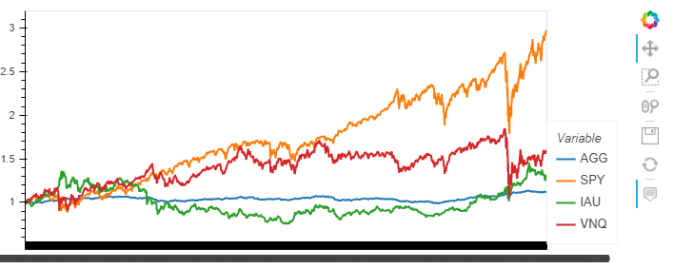
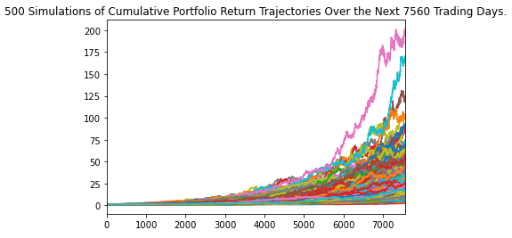
Data Analysis
Historical and Simulated Info
To help our client make an educated choice of which assets they may want to invest in, we plotted cumulative returns as well as a rolling standard deviation for each asset category
We then ran a Monte Carlo analysis based on the user’s selections for:
Target retirement age
Asset selection
Tolerance for risk
Amount of money to invest

Slide 7




Our Findings
Goals
Conclusions
Get User Inputs
Delaying investments or only using a traditional savings account has a tremendous impact on long-term retirement funds
Update the MC criteria
 | Savings Account | Stocks and Bonds
Initial Investment | $20,000 | $20,000
Annual Contribution | $5,000 | $5,000
Years | 35 | 35
Result | $172,804 | $1,026,658
Create a tailored dashboard
Results
User inputs allowed for dynamic variables
Zero code manipulation required
In this one illustrative example, the user can see an opportunity cost of $839,854!
Costs were kept low through a scalable, user-driven experience
Dashboard successfully reflected user-specific Monte Carlo simulation

Slide 8
Postmortem/If We Had More Time
Allow for rebalancing of the portfolio
Allow more advanced users to select of other asset classes or individual stocks
Allow for more dynamic recurring investment contributions (annual, quarterly, monthly, etc.)
Show the impact fees and expenses can have on portfolio return
Create a front-end website to create a more user-friendly way of inputting user data

Slide 9
Q&A

